Slide 1
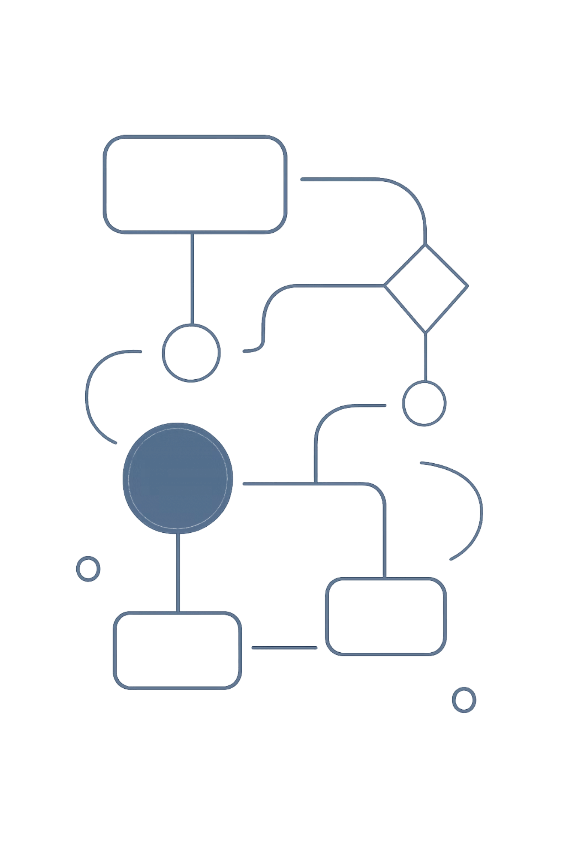
Introduction to Data Structures & Algorithms
A beginner's journey through the "what" and "how" of data — with Java, C++, and Dart.
JAVA
C++
DART

Slide 2


Data Structures & Algorithms
The Core Idea
"Data structures hold data, while algorithms are used to resolve the problem of data."
Data Structure
Algorithm
The container or format that holds your data.
The set of steps used to solve a problem using that data.
Analogy: A cabinet with drawers is a data structure. How you search, sort, or arrange those drawers is the algorithm. Understanding both lets you ask not just "does it work?" but "why does it work this way, and how efficiently?"

Slide 3
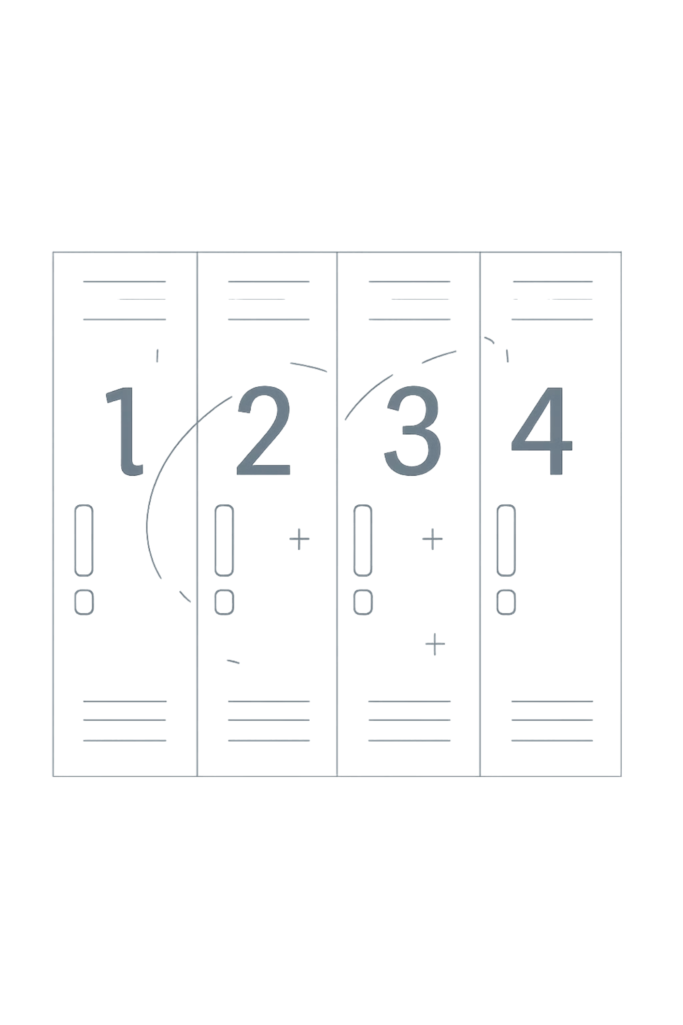

How Data Actually Lives in Memory
Every variable is stored in a numbered memory slot — an address. Think of a hallway of lockers, each with a unique number.
01
Find an empty locker
The computer locates a free memory slot.
02
Label it with an address
Each slot gets a unique memory address.
03
Place the value inside
int score = 10; — value 10 goes in the locker.
04
Remember the number
The address is stored so the value can be fetched later.
Why it matters: Arrays = adjacent lockers (fast index access). Linked Lists = scattered lockers, each holding a note pointing to the next. This is why data structures directly affect algorithm speed.

Slide 4


Stack — Last In, First Out
🍽️ Analogy: A Stack of Plates
You can only take from the top and add to the top. The last plate placed is the first removed — LIFO.
Real-World Use — Undo (Ctrl+Z): Every action is pushed onto a stack. Pressing Ctrl+Z pops the most recent action first — exactly LIFO behavior.
Push
Pop
Add item to top
Remove from top

Slide 5

Queue — First In, First Out
🚌 Analogy: The Jeepney Line
The first person to queue is the first to board. Newcomers join at the back. Order is always preserved — FIFO.
Real-World Use — Printer Queues: Documents sent to a shared printer are queued. The first document sent is the first printed — no jumping the line. Same logic applies to ticket booking systems.
Enqueue
Dequeue
Join the back of the line
Leave from the front

Slide 6
From Plain English to Pseudocode
Let's build a stack that can check if it's empty, add items, and display them. Structural names use Tagalog while explanations stay in English.
Pseudocode
Java Translation
STRUCTURE Tumpok (Stack)
LIST mgaSalansan
FUNCTION walangLaman()
RETURN true IF empty
FUNCTION ipasok(halaga)
ADD halaga to end
FUNCTION ipakita()
PRINT all items
END STRUCTURE
class Tumpok {
ArrayList<Integer> mgaSalansan
= new ArrayList<>();
boolean walangLaman() {
return mgaSalansan.isEmpty();
}
void ipasok(int halaga) {
mgaSalansan.add(halaga);
}
void ipakita() {
System.out.println(mgaSalansan);
}
}

Slide 7

Code Translation — C++ & Dart
C++ Version
Dart Version
class Tumpok {
vector<int> mgaSalansan;
bool walangLaman() {
return mgaSalansan.empty();
}
void ipasok(int halaga) {
mgaSalansan.push_back(halaga);
}
void ipakita() {
for (int x : mgaSalansan)
cout << x << " ";
}
};
class Tumpok {
List<int> mgaSalansan = [];
bool walangLaman() {
return mgaSalansan.isEmpty;
}
void ipasok(int halaga) {
mgaSalansan.add(halaga);
}
void ipakita() {
print(mgaSalansan);
}
}
Same Tagalog method names, same logic — only syntax differs. The algorithm stays identical across languages.

Slide 8


Linear Search — The Concept
Linear search checks every item one by one until it finds the target or reaches the end.
Best Case — O(1)
Target is the first item. One check, done immediately.
Worst Case — O(n)
Target is last or not present. Every item must be checked.
Analogy: Looking for a name in an unsorted list — you must check each entry one by one. No shortcuts.

Slide 9
Linear Search — Code Across Languages
Java
C++
int linearSearch(int[] arr, int target) {
for (int i = 0; i < arr.length; i++) {
if (arr[i] == target) return i;
}
return -1;
}
int linearSearch(int arr[], int n, int target) {
for (int i = 0; i < n; i++) {
if (arr[i] == target) return i;
}
return -1;
}
// Dart
int linearSearch(List<int> arr, int target) {
for (int i = 0; i < arr.length; i++) {
if (arr[i] == target) return i;
}
return -1;
}
All three return the index if found, or -1 if not. Same logic, different syntax.

Slide 10

What Comes Next
You've covered the foundations. Now it's time to build on them.
Sorting
Bubble Sort, Selection Sort, Insertion Sort
Recursion
Functions that call themselves to solve smaller sub-problems
Trees & Graphs
Non-linear structures for hierarchical and networked data
Practice
Apply concepts on platforms like LeetCode or HackerRank
"Learning DSA is like learning grammar before writing essays. You need the rules before you can break them wisely."

